Slide 1
Getting started in an Industrial Research Lab: A personal perspective
Sriram Rajamani
Microsoft Research India

Slide 2
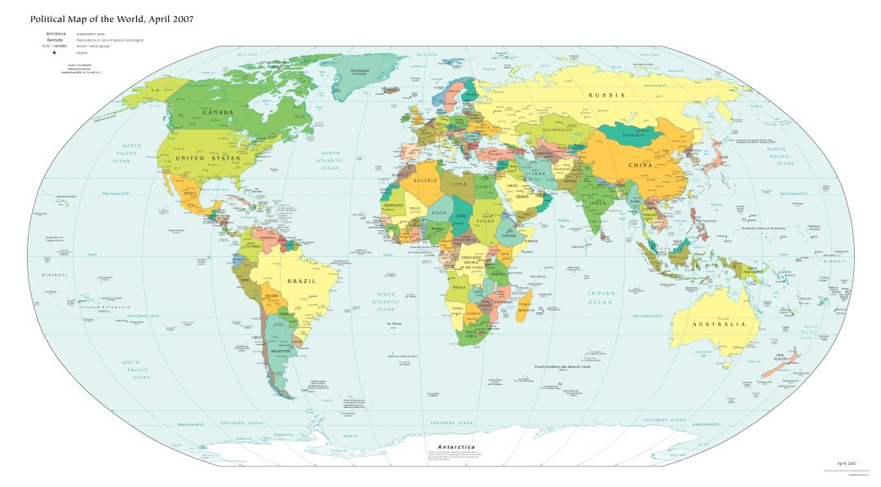
Seattle
Berkeley
Charlottesville
Bangalore
Chennai
PhD, UC Berkeley 1999 (in formal verification)
  Before doing a PhD I worked as a programmer for ~5 years
Joined Microsoft Research Redmond in 1999
  MSR was a small organization in 1999 –I was one of the first “verification” researchers to join MSR
  Became manager of “Software Productivity Tools” in 2003
Moved to MSR India in 2005, shortly after it was formed
  Founded the “Rigorous Software Engineering Group” at MSR India
Assistant Managing Director of MSR India since 2009

Slide 3
Scope
My talk will primarily target young researchers at Industrial research labs (though some parts may be useful even if you are in academia)
I am assuming a lab environment with “a lot of freedom” such as Microsoft Research (though some parts may be useful even if you work for a lab with “less freedom”)
Even if you don’t work in a lab, you might learn about life in research labs from this talk…and figure out how to collaborate with people in research labs better

Slide 4
Questions you might have…
  What are the best topics to work on?
  Should I continue to work on things following up from my thesis should I explore new topics?
  Should I try and help my company, or should I help advance science?
  Who should I collaborate with?
  Should I teach (at a university) on the side?
  Should I supervise students on the side?
  Part I: Research Agenda
  Part II: Collaborations
  Part III: Teaching and mentoring students

Slide 5
Part I: Research Agenda
  Part I: Research Agenda
  Part II: Collaborations
  Part III: Teaching and mentoring students

Slide 6
Research agenda
What problem should I work on?
Single most important question that will determine your research career, more than anything else….

Slide 7
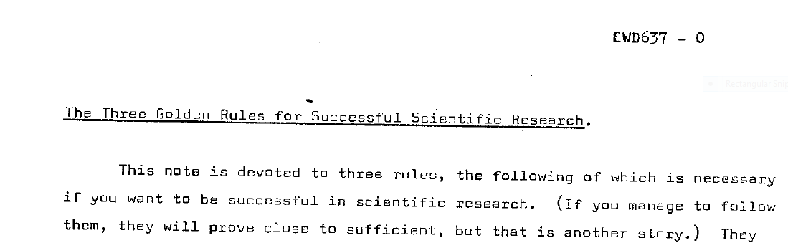
Let’s listen to Dijkstra..
EWD637, “Selected Writings on Computing: A personal perspective”, 1982

Slide 8
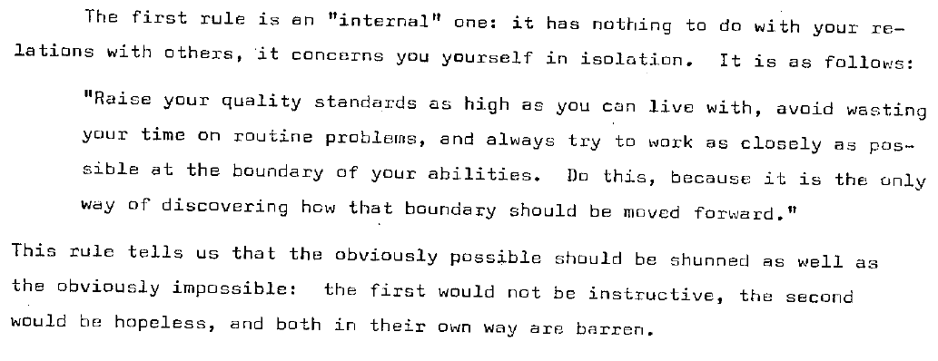
Rule 1: Pick a problem that is not routine, not impossible to solve…

Slide 9
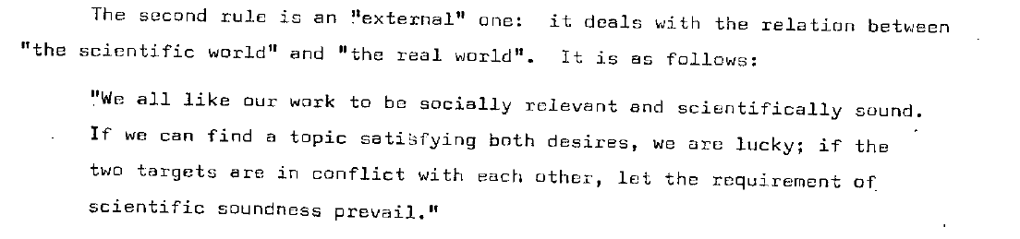
Rule 1: Pick a problem that is not routine, not impossible to solve…
Rule 2: …Scientific soundness (of solution)….

Slide 10
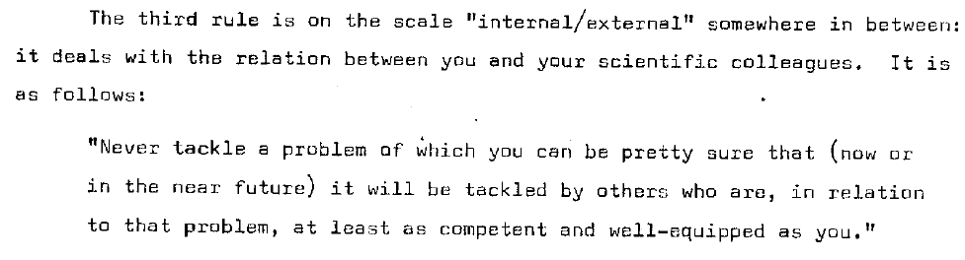
Rule 1: Pick a problem that is not routine, not impossible to solve…
Rule 2: …Scientific soundness (of solution)….
Rule 3: Pick a problem where you have a unique advantage

Slide 11
Rule 1: Pick a problem that is not routine, not impossible to solve…
Rule 2: …Scientific soundness (of solution)….
Rule 3: Pick a problem where you have a unique advantage
In an industrial lab, the presence of realistic “industrial strength” data, and access to users is a unique advantage.
Pick problems where you and your collaborators have unique skills and background to do an exceptional job
But make sure that Rule 1 and Rule 2 are satisfied, otherwise you will do incremental research!

Slide 12
Scientifically interesting problems
Problems of interest to company
Pick problems in the intersection!

Slide 13
Simplicity: Distilling the essence
Almost any practical problem offers interesting research challenges if you dig deep enough. Even if your company/environment requires you to work on some specific, practical, problem, dig deep and you will reveal research opportunities.
Where an engineer or developer might stop with a “solution that works”, a researcher continues to refine and perfect both the problem formulation and the solution. Real-world problems can be a tangled mess of many concerns. Part of a researcher’s job is to distill the essence of a problem. And to then distill the essence of a solution. Researchers should aim for simplicity.
A quotation (due to Antoine de Saint-Exupery): “Perfection is achieved, not when there is nothing more to add, but when there is nothing left to take away.”
Why is simplicity important? Newton is supposed to have said that he saw further because he stood on the shoulders of a giant. That giant has grown much taller since Newton’s time. All researchers need to climb up to the shoulders of the giant. But how is it possible for researchers to understand and digest the sheer volume of work that has been done previously (few decades worth of work in Computer Science or a few centuries worth of work in Mathematics) and make further progress? It is because a complex idea that took a lot of time to evolve can be eventually simplified so that a new person can grasp it in far less time … and make further progress. Simplicity is fundamental for a research community to make collective progress.
G Ramalingam

Slide 14
Should I continue working on my thesis?
It is easier for your career if you can smoothly transition from your PhD topic to the next one, and so on throughout your career. Abrupt transitions are difficult, stressful and risky (as you may not get any results for a while).
On the other hand…. “the most successful researchers are those who forget quickly about their PhD theses”: the reason is that your PhD topic might have been largely defined by the pet topic and interests of your PhD advisor; if you forget about this topic, you can listen more carefully to the problems faced in your new working environment (i.e., that industrial lab where you now work) and then more quickly get results on those problems, for which your new employer will be more grateful, which in turn may make you happier (and wealthier ☺)
Patrice Godefroid

Slide 15
Make use of real world data..
You are in the unique position to obtain real world data/software and that will definitely come in handy to decide what you want to do next.
Aditya Nori

Slide 16
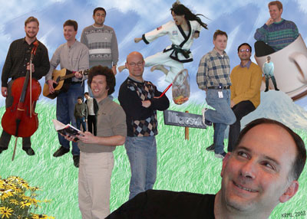
MSR SPT group @ 1999..
Reliability was important to Microsoft (worms and viruses were running amuck)
Research community was also very interested in this are
Coming together of communities:
Model checking
Theorem proving
Program analysis

Slide 17
SPT decided to focus on low level systems code (device drivers):
SLAM (Ball & Rajamani)
Vault (Deline & Fahndrich)
ESP (Das)
Different approaches (model checking, theorem proving and program analysis) to solve the same problems
Real problems, real users to validate solutions
Our work was published extensivey (in CAV, PLDI, POPL, ICSE, FSE, ..)
Some of it was adopted by the company

Slide 18
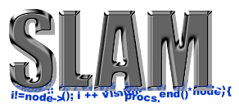
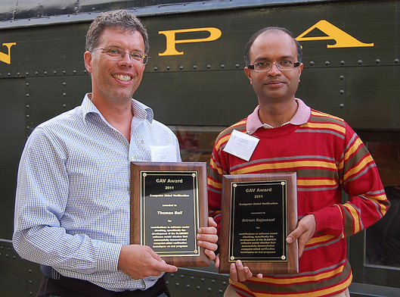
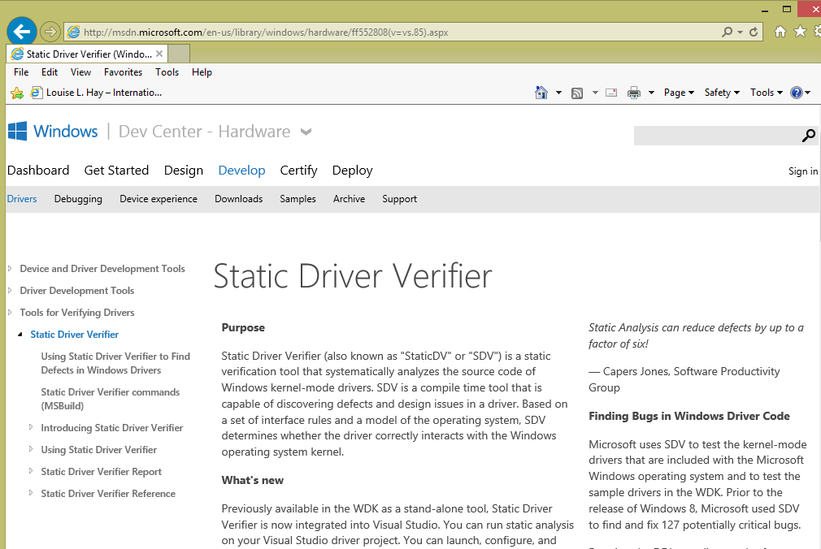

Slide 19
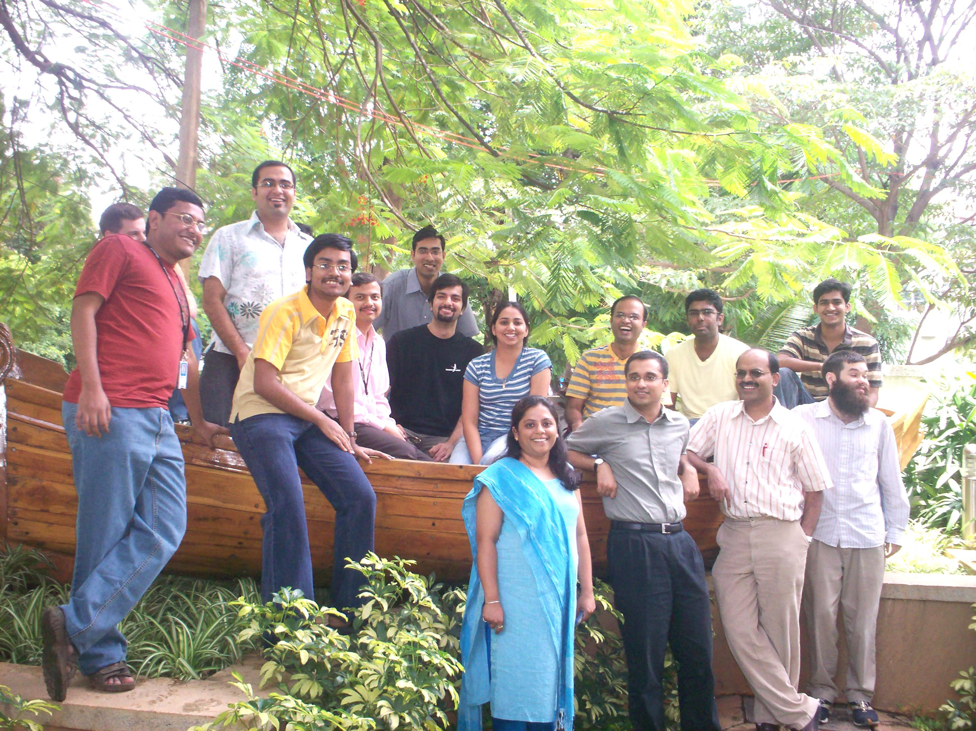

Slide 20
Sometimes your company may have important problems to solve, that don’t need new research
By all means, help your company. It is a good thing to do.
  But be clear that you are doing “consulting” and not research
  Don’t try and write papers on such work, unless they add to body of knowledge. Otherwise, you will waste your time and the community’s time writing incremental papers
Often, such “consulting engagements” help you build relationships with product groups and you can learn about their problems more comprehensively, some of which may need new research

Slide 21
Summary: Pick problems…
Which you find interesting and challenging scientifically
Which are not easy and not impossible
Which your employer cares about
Where your company has unique data, users etc that are not accessible to others, so that you have a unique advantage
Where you and your collaborators have unique expertise/insights/advantage to make a difference
Simplify, simplify, simplify: get to the essence

Slide 22
Part II : Collaborations
  Part I: Research Agenda
  Part II: Collaborations
  Part III: Teaching and mentoring students

Slide 23
Collaborators
Who should I collaborate with?

Slide 24
Collaborators
One of the big advantages of an industrial lab is the presence of experts
Learn as many new things as you can from your colleagues!
Find people who have different areas of expertise than you, and work with them
Have fun during collaborations, and build life-long friendships!

Slide 25
Collaborators
Personally, I prefer collaborating with people who have different, complementary expertise to mine.
This is another advantage of doing research in an industrial lab: you will have more chances to collaborate with peers, especially with more senior researchers who will help you indirectly (as “role models”) becoming a better researcher yourself
Patrice Godefroid

Slide 26
Collaborators
Pick a mix of senior and junior people. This is help in the former case get a broader perspective on the field and on the latter case work with someone who can dig in the trenches with you. Also be careful of working with everyone in your area outside of your company as you could create conflicts of interest with a lot of people who would potentially be great reviewers for your research work but who will not be able to do so because of conflicts. This can lead to a situation where your work will be evaluated by non-experts which is not very desirable
Nachi Nagappan

Slide 27
My own collaborators
Helped me work on Machine Learning, come to my “Probabilistic Programming” talk @ FOSE on Friday
Top 5 collaborators from DBLP:
  Aditya Nori, 21 DBLP entries
  Tom Ball, 20 DBLP entries
  Shaz Qadeer, 15 DBLP entries
  Tom Henzinger, 15 DBLP entries
  Jakob Rehof, 8 DBLP entries
SLAM = program analysis + model checking + theorem proving
Grad school + MSR
PhD Advisor
Types + Model checking

Slide 28
My own collaborators
My other significant collaborators:
Andreas Podelski (abstract interpretation)
G Ramalingam, Kapil Vaswani, Kaushik Rajan (PL/tools for distributed systems)
Joseph Joy, Developer @ Microsoft
Ramarathnam Venkatesan (PL and cloud security)
Top 5 collaborators from DBLP:
  Aditya Nori, 21 DBLP entries
  Tom Ball, 20 DBLP entries
  Shaz Qadeer, 15 DBLP entries
  Tom Henzinger, 15 DBLP entries
  Jakob Rehof, 8 DBLP entries

Slide 29
What has worked for me..
Find collaborators that have different expertise than you
First few papers are difficult to write, but then it gets much better and you start to do very novel things.
Hang out with them, make friends, have a good time!

Slide 30
Collaborations: Inviting visiting researchers
Invite visiting researchers
Professors on sabbaticals, researchers from government labs etc
Even if you don’t have a concrete collaboration with them, if you find them and their work interesting (and can work out budget) just invite them anyways!
Don’t invite visitors unless you can spend sufficient time with them!

Slide 31
Part III: Teaching and mentoring students
  Part I: Research Agenda
  Part II: Collaborations
  Part III: Teaching and mentoring students

Slide 32
Internships
Great way to work with students
Upside: students bring freshness, raw energy, try different approaches to problems, and allow experimentation with different approaches
Downside: need to “take over” code from interns when the leave.
Bliss: if you “click” with the student, you can become co-advisor for student’s PhD and work with them through their PhD
A recruiting tools for research labs
  What I have learnt from successful internships:
  Think through the problem and approach well before the intern comes
  Give the intern clear, but ambitious goals
  Work with the intern closely, particularly when they get stuck and keep up the momentum ( 3 months fly quickly)

Slide 33
Teaching
Is a wonderful thing to do, but consumes a lot of time and effort
I have taught 3 courses so far (all of them since returning to India) to build a community in program analysis/verification
Aditya Nori says: “You get to experience of interacting with very bright students and influencing them and in many cases, learning from them. Sometimes teaching a new topic is the best way to learn it yourself.”
Patrice Godefroid says: “Yes, as long as it supports and enhance your main research goals or career development. (In contrast, don’t teach just to teach – if teaching is your main passion, go to academia.)”

Slide 34
Advising students
You can serve on PhD thesis committees (can be very rewarding for both you and the student)
Works well if the student has interned with you and you know the student’s work
Works even better if you collaborate with the student and their advisor

Slide 35
Summary & Discussion
Pick problems
Which you find interesting and challenging scientifically
Which are not easy and not impossible
Which your employer cares about
Where your company has unique data, users etc that are not accessible to others, so that you have a unique advantage
Where you and your collaborators have unique expertise/insights/advantage to make a difference
Simplify, simplify, simplify: get to the essence
Pick collaborators
Who have complementary skills
Mix of backgrounds, mix of senior/junior people
Learn from your collaborators
Host faculty on sabbaticals (and spend time with them!)
Mentoring and teaching
Internships are great way to work with students, and keep you intellectually young
Co-advising students is a great way to collaborate with faculty in academia
You learn a topic better if you teach (but teaching is a big time investment)
Acknowledgment:
Patrice Godefroid, Nachi Nagappan, Aditya Nori, G Ramalingam

Slide 36
